Slide 1
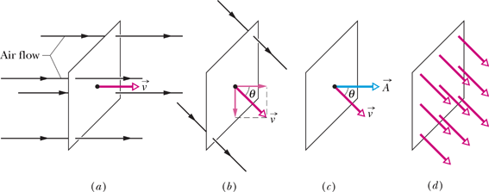
Flux
The rate of volume flow through the loop is :

Slide 2
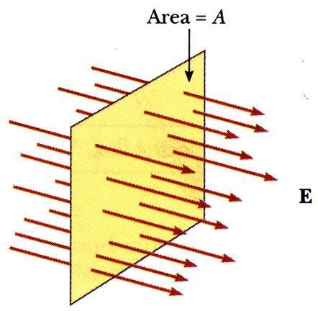
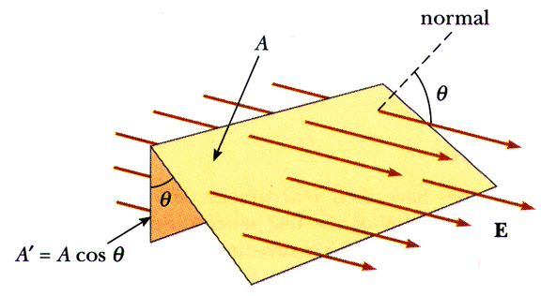
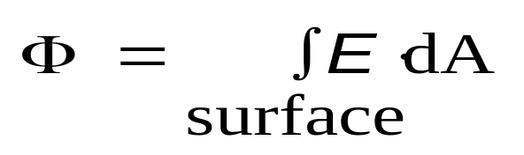
Definition of Electric Flux
The amount of field, material or other physical entity passing through a surface.
Surface area can be represented as vector defined normal to the surface it is describing
Defined by the equation:

Slide 3
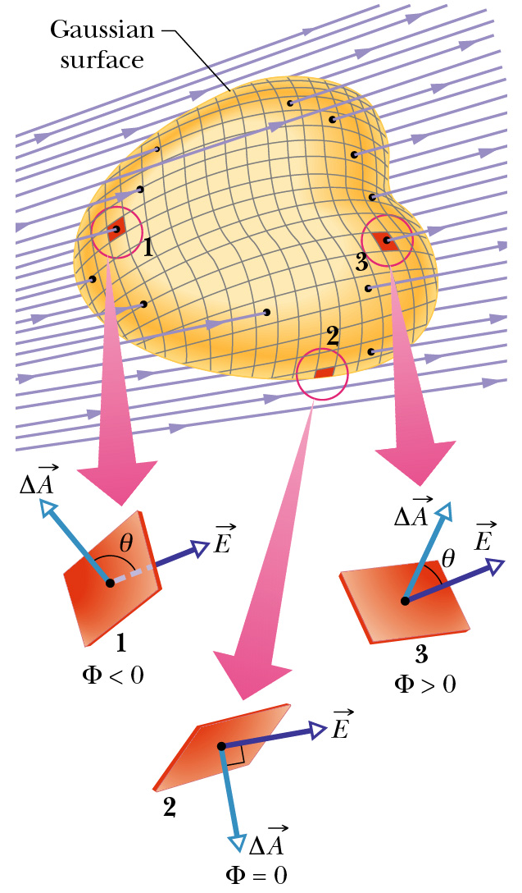


Flux of Electric Field
Like the flow of water, or light energy, we can think of the electric field as flowing through a surface (although in this case nothing is actually moving).
We represent the flux of electric field as Φ (greek letter phi), so the flux of the electric field through an element of area ΔA is
When θ < 90˚, the flux is positive (out of the surface), and when θ > 90˚, the flux is negative.
When we have a complicated surface, we can divide it up into tiny elemental areas:

Slide 4
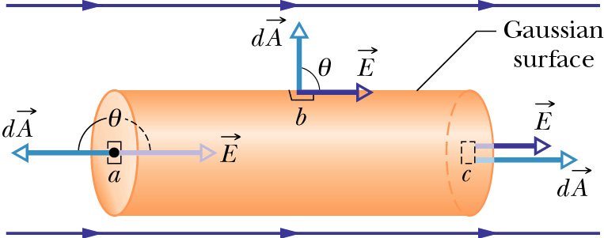
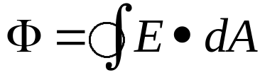
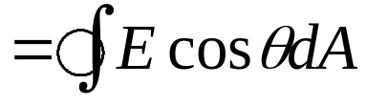

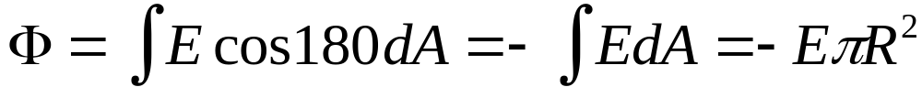
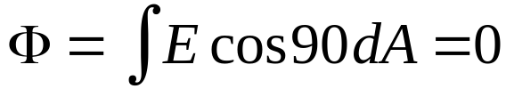
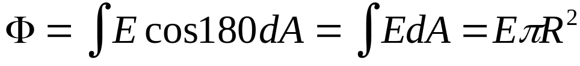
Find the electric flux through a cylindrical surface in a uniform electric field E
a.
b.
What is the flux if the
cylinder were vertical ?
c.
Suppose it were
any shape?
Summer July 2004
Flux from a. + b. + c. = 0

Slide 5
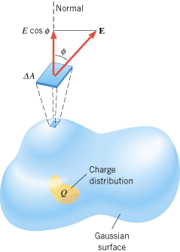
Gauss’ Law
For charge distribution Q:
The electric flux through a Gaussian surface times by ε₀ ( the permittivity of free space) is equal to the net charge Q enclosed :
The net charge q_{enc} is the algebraic sum of all the enclosed charges.
Charge outside the surface, no matter how large or how close it may be, is not included in the term q_{enc}.

Slide 6
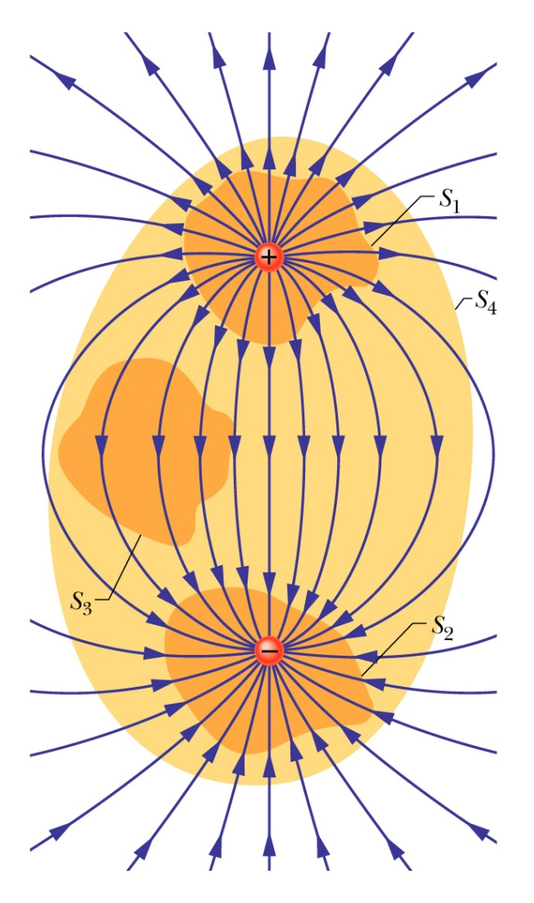
Example of Gauss’ Law
Consider a dipole with equal positive and negative charges.
Imagine four surfaces S₁, S₂, S₃, S₄, as shown.
S₁ encloses the positive charge. Note that the field is everywhere outward, so the flux is positive.
S₂ encloses the negative charge. Note that the field is everywhere inward, so the flux through the surface is negative.
S₃ encloses no charge. The flux through the surface is negative at the upper part, and positive at the lower part, but these cancel, and there is no net flux through the surface.
S₄ encloses both charges. Again there is no net charge enclosed, so there is equal flux going out and coming in—no net flux through the surface.

Slide 7
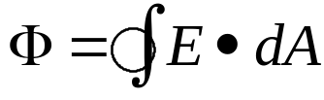
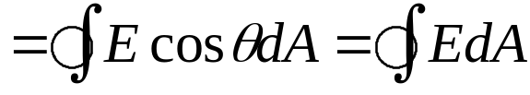
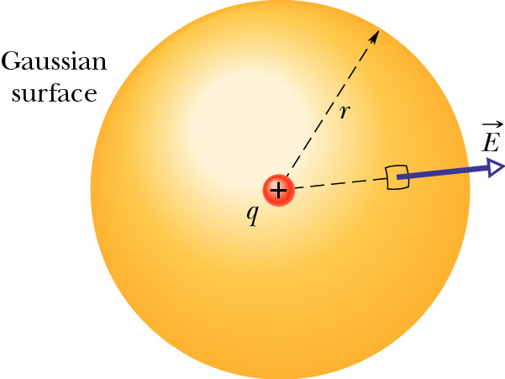
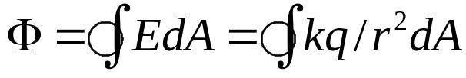
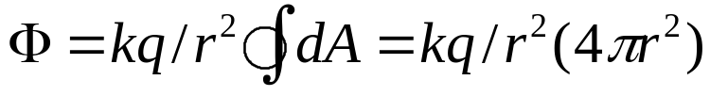


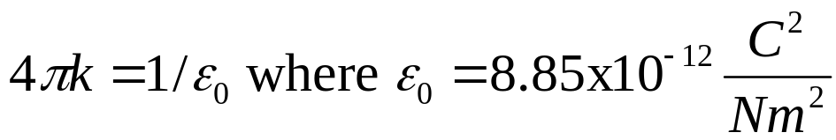

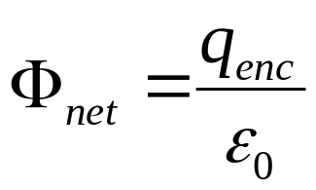
Electric lines of flux and
Derivation of Gauss’ Law using Coulombs law
Consider a sphere drawn around a positive point charge. Evaluate the net flux through the closed surface.
Net Flux =
E II n
Cos 0 = 1
For a Point charge E=kq/r²
dA
Gauss’ Law

Slide 8
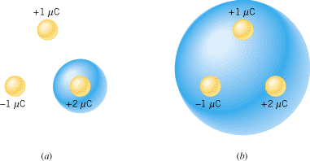
Check Your Understanding
The drawing shows an arrangement of three charges. In parts (a) and (b) different Gaussian surfaces are shown. Through which surface, if either, does the greater electric flux pass?

Slide 9

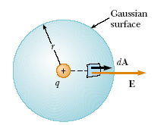




Slide 10
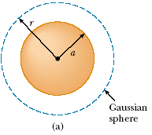

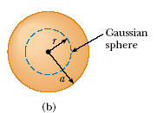


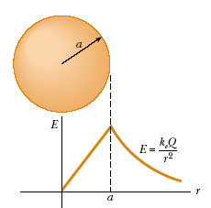


Slide 11


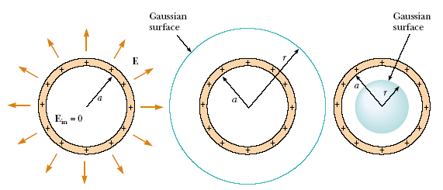
A shell of uniform charge attracts or repels a charged particle that is outside the shell as if all the shell's charge were concentrated at the center of the shell.
If a charged particle is located inside a shell of uniform charge, there is no electrostatic force on the particle from the shell.

Slide 12
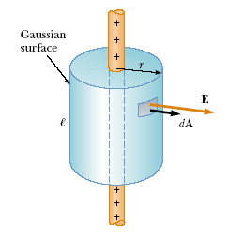

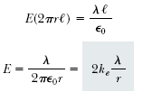
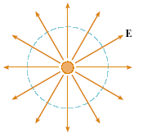

Slide 13

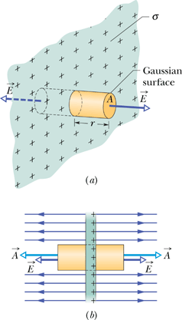
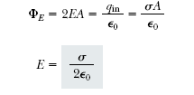

Slide 14
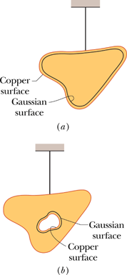
A Charged Isolated Conductor
If an excess charge is placed on an isolated conductor, that amount of charge will move entirely to the surface of the conductor. None of the excess charge will be found within the body of the conductor.
For an Isolated Conductor with a Cavity, There is no net charge on the cavity walls; all the excess charge remains on the outer surface of the conductor

Slide 15


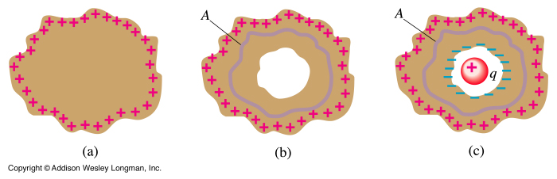
Find electric charge q on surface of hole in the charged conductor.

Slide 16
The solution of this problem lies in the fact that the electric field inside a conductor is zero and if we place our Gaussian surface inside the conductor (where the field is zero), the charge enclosed must be zero (+ q – q) = 0.
Find electric charge q on surface of hole in the charged conductor.

Slide 17
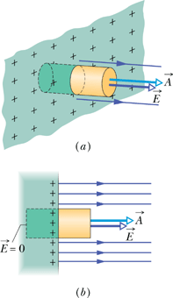
The External Electric Field of a Conductor
If σ is the charge per unit area,
according to Gauss' law,

